Slide 1

Sentiment Analysis Using Natural Language Processing
Group Number: 7
Project: 5
Aashutosh Sehgal (0780170)
Dattu Reddy Pedholla (0782042)
Devashish Patel (0781214)
Rohit Rohit (0773987)
Rachna Rachna (0782821)

Slide 2

Overview of problem
The objective of this project is to analyse the sentiments behind the reviews that the hotel received over the period of time. We will use natural language processing to understand how people felt and was the review positive or negative for the restaurant.

Slide 3
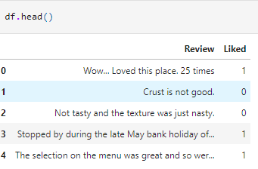
Review of Data Source
The dataset named Restaurant Review, it is a tab separated data, with 2 columns.
The columns are defined as follows:
Review – It is review which customers wrote.
Liked – It is indicator of whether they like the restaurant or not 1 is for liked and 0 for disliked.

Slide 4






Text Processing and it’s application
We will be using NLTK (natural language toolkit) to process text data.
From the toolkit itself, we will download “Stopwords” to remove the non-essential words.
Stemming means taking the root of the word such as love from loved or loving, for this we will use “PorterStemmer” again from the toolkit.
Now using all these things mentioned above, we will apply it to our review column.

Slide 5


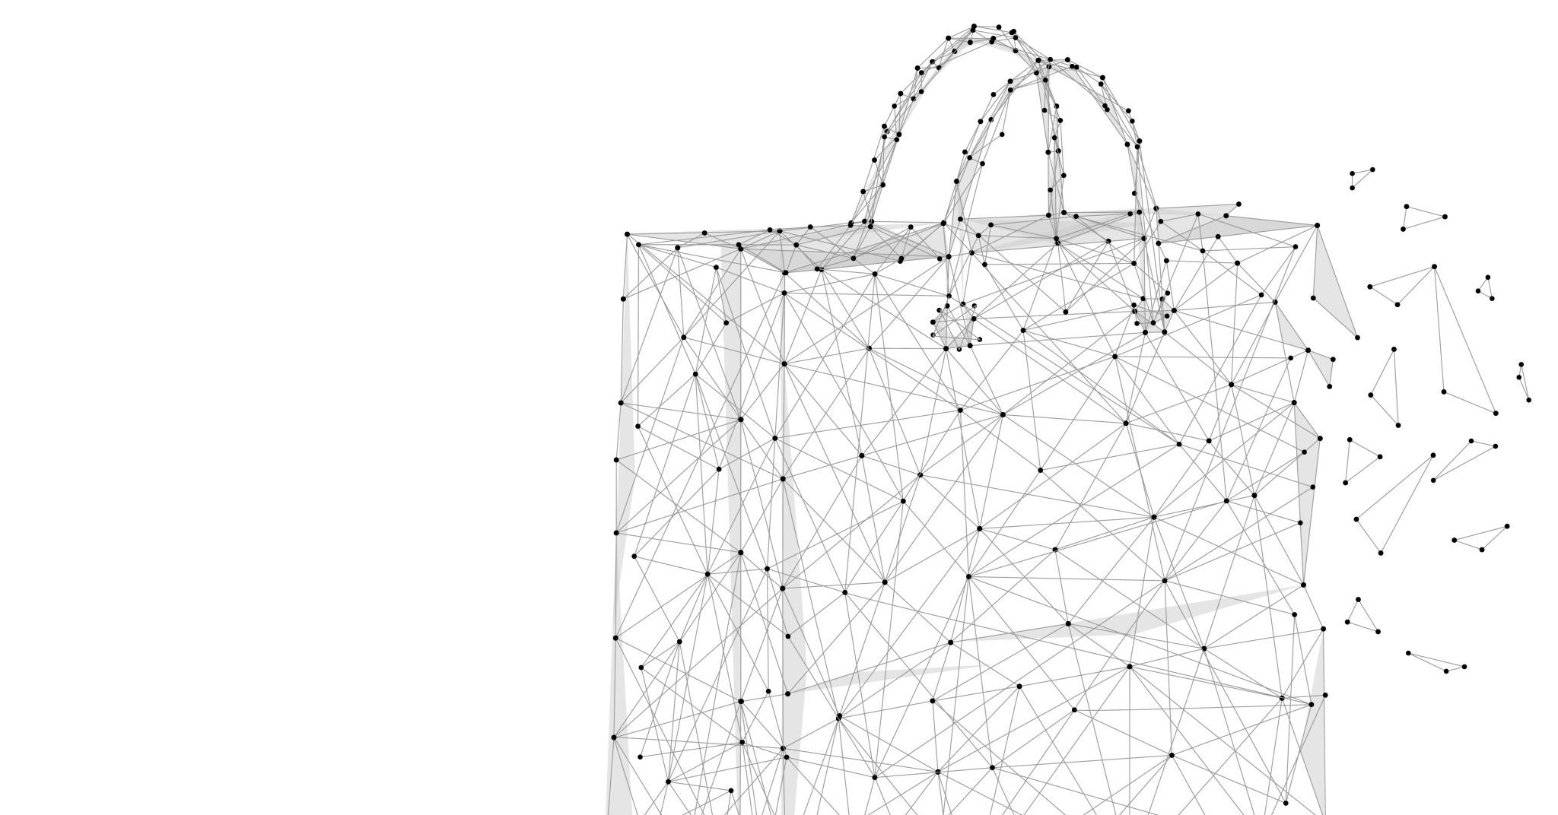


Feature extraction using Bag of Words model

Slide 6

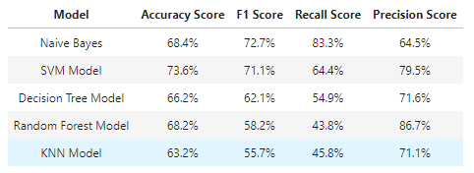
CountVectorizer and 5 Machine Learning Models
Here we will use top 1500 most frequent words to apply it to our dataset and then compare it with our target variable of whether the customer liked or not.

Slide 7
Feature extraction using TF IDF model

Slide 8
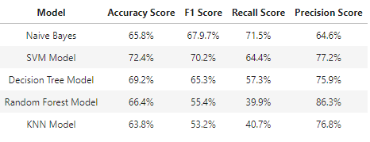
TF IDF and 5 Machine Learning Models
TF-IDF (term frequency-inverse document frequency) is a statistical way to measure and evaluates relevancy of a word in document in a collection of documents. To do this we multiplying two metrics one being how many times a word appears in a document, and secondly the inverse document frequency of the word across a set of documents.

Slide 9


RESULTS
From the score seen before of all the machine learning models for both Bag of Words and TF IDF model, we can say that Support Vector Machine (SVM) is the most appropriate machine learning model combined other natural language toolkit tools for our data to predict whether the consumer liked or restaurant or not.

Slide 10
Future recommendations/PROPOSAL
From the text analysis using natural language processing and machine learning, we can recommend restaurant that:
As we see more and more use of natural language processing, the restaurant should start marketing based on how customers feel in their reviews.
Another study can be conducted to form word clouds of words that are used to express good or bad and based on that we can launch marketing campaign to attract more customers.
As we see words themselves express a lot, thus we can use the words themselves to the work for us we can use Search engine optimizations, using hashtags when posting or referring to the restaurant on social media or on the website and thus getting digital marketing take in-charge.

Slide 11
THANK YOU

